Slide 1

Intelligent Agents Codebase
Group 3: Presentation

Slide 2
Contents
Introduction
Design
Development Environment
Code Quality
Formatting, Linting and Reviews
Testing, Coverage and Report
Metrics and Repository
Commenting and Documenting
Codebase References
BOT Running
Explaining the ini configuration file
Process & Code Flow
Conclusion

Slide 3
Introduction
This presentation introduces with the coding approach and implementations for the “digital forensics” prototype design that is responsible to
monitor,
identify,
find
and move files.
Based on the “iterative pattern”, the design proposed for the development of the BOT has undergone further team reviews to ensure that the BOT is self-sufficient and works using a configuration that becomes the data inputs for the BOT to process accordingly.
With regular team reviews of the approach and an understanding of the complexities, the development used a brief TDD (Test Driven Development) approach for the first rollout of the prototype. The initial release of the prototype (MVP1) was outlined to fulfil requirements that can be delivered on time as a baseline and enabler for future enhancements.

Slide 4
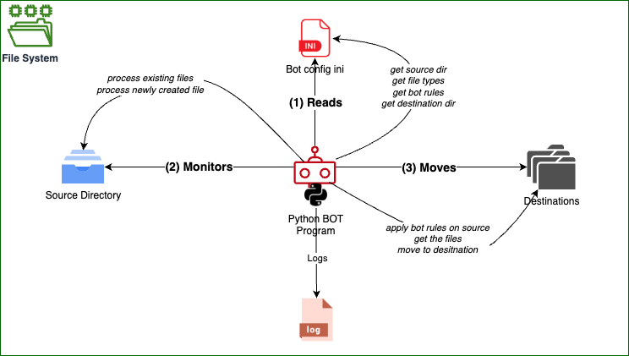
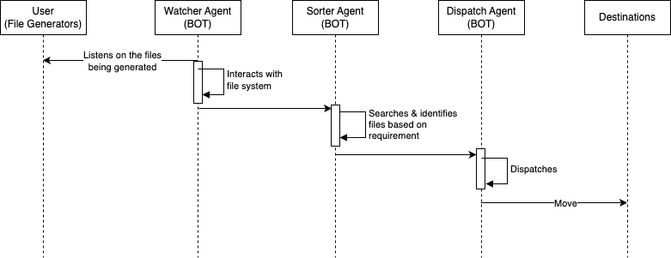
Design
Three main functions:
(1) READ
(2) MONITOR
(3) MOVE

Slide 5
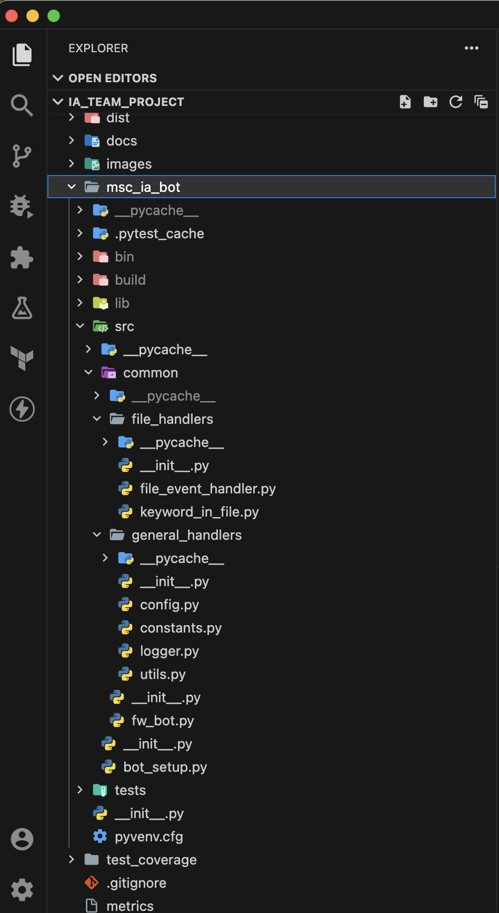
Development Environment
Virtual Environment
python 3.10.11
pip 23.1.2
pipdeptree 2.9.5
Code quality
pytest 7.4.0 (unit testing)
radon 6.0.1 (code metrics)
Sphinx 7.0.1 (code comments and documentation)
coverage 7.2.7 (code coverage)
Dependencies
watchdog 3.0.0
colorama 0.4.6
openpyxl 3.1.2
PyPDF2 3.0.1
Paramiko 3.2.0
Zipp 3.16.0
python-docx 0.8.11
urllib3 2.0.3
lxml 4.9.3
et-xmlfile 1.1.0
Code Repository
Github (https://github.com/biswassandip/IA_Team_Project)
IDE
Visual Studio Code (vscode)
Extenstions
autopep8
Pylance
Mypy Type Checker
Pylint
FOLDER STRUCTURE
Setting up the environment
Create Git repository in Github
Clone the repository in development environment
Create the virtual environment (ex; msc_ia_bot)
Activate the virtual environment
Install dependencies and code quality libraries
Open the folder msc_ia_bot in vscode
Add vscode extentions
Select the interpretor in vscode
Create required folders
Happy coding

Slide 6



Code Quality (formatting, linting and reviews)
analyse your code for potential errors, style violations, and best practice adherence
Consistent Code Formatting, Linting & Static Type Checking
pylint
autopep8
Team Reviews
mypy
enforce type annotations and catch potential type-related errors before runtime.

Slide 7
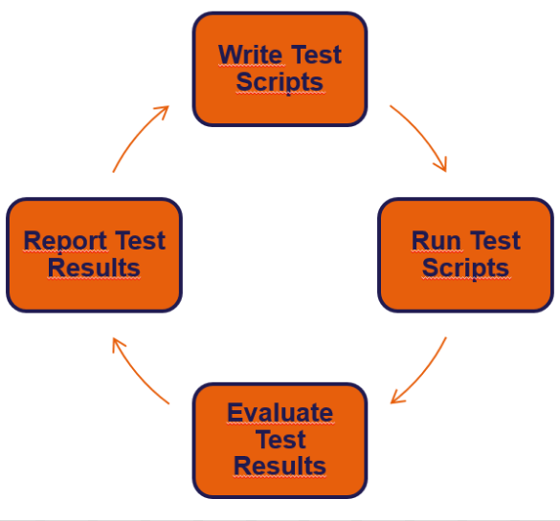

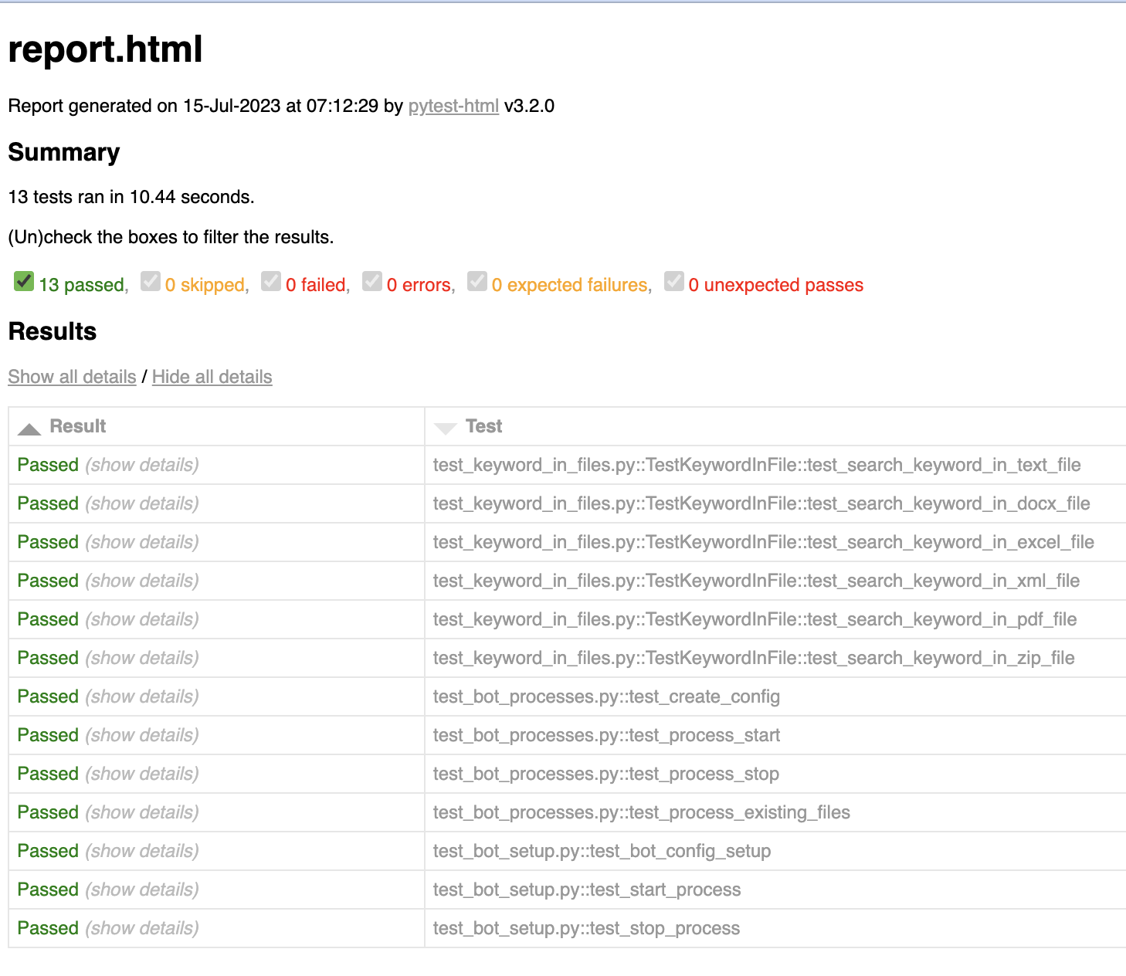
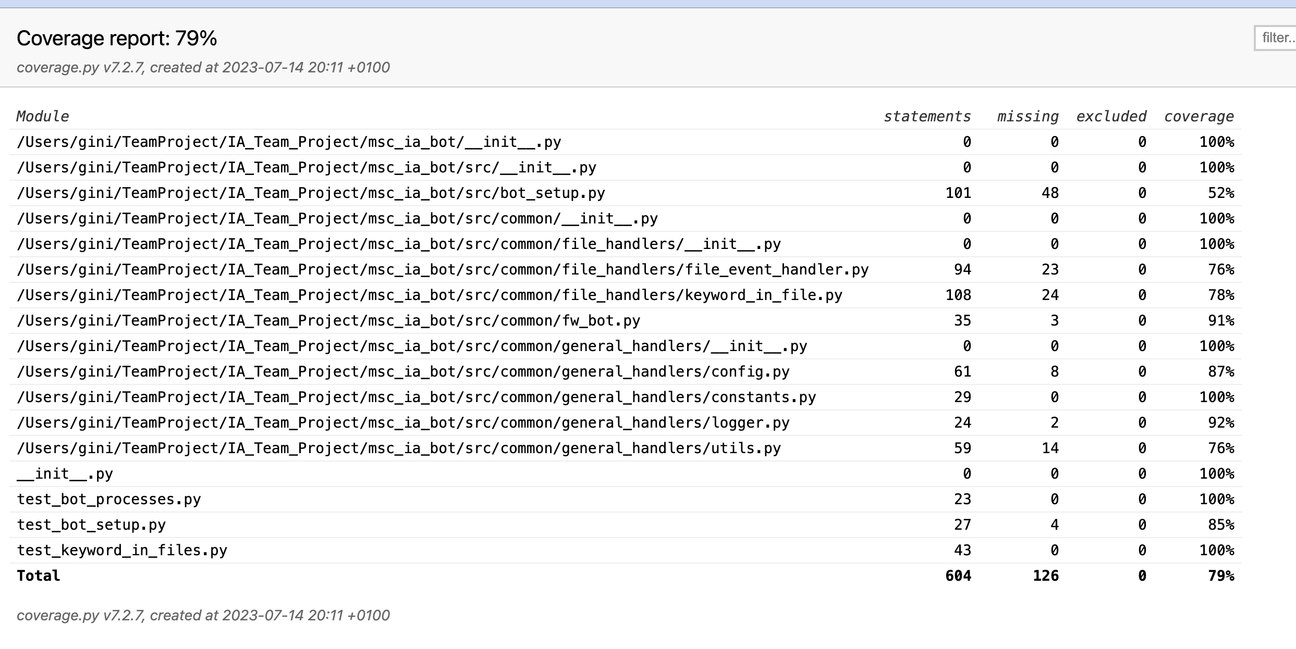
Code Quality (testing, coverage and report)
Refer: https://htmlpreview.github.io/?https://github.com/biswassandip/IA_Team_Project/blob/main/msc_ia_bot/tests/report.html
Refer: https://htmlpreview.github.io/?https://github.com/biswassandip/IA_Team_Project/blob/main/test_coverage/index.html
pytest
coverage
Testing & coverage
Test Run Report

Slide 8
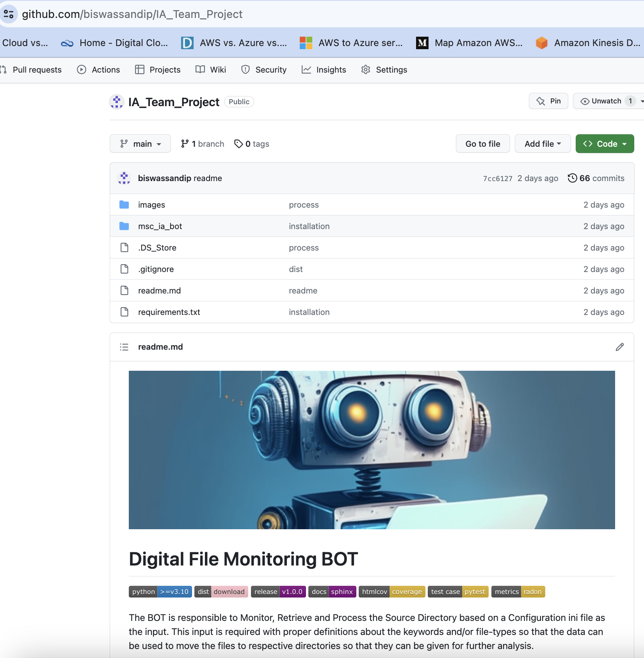
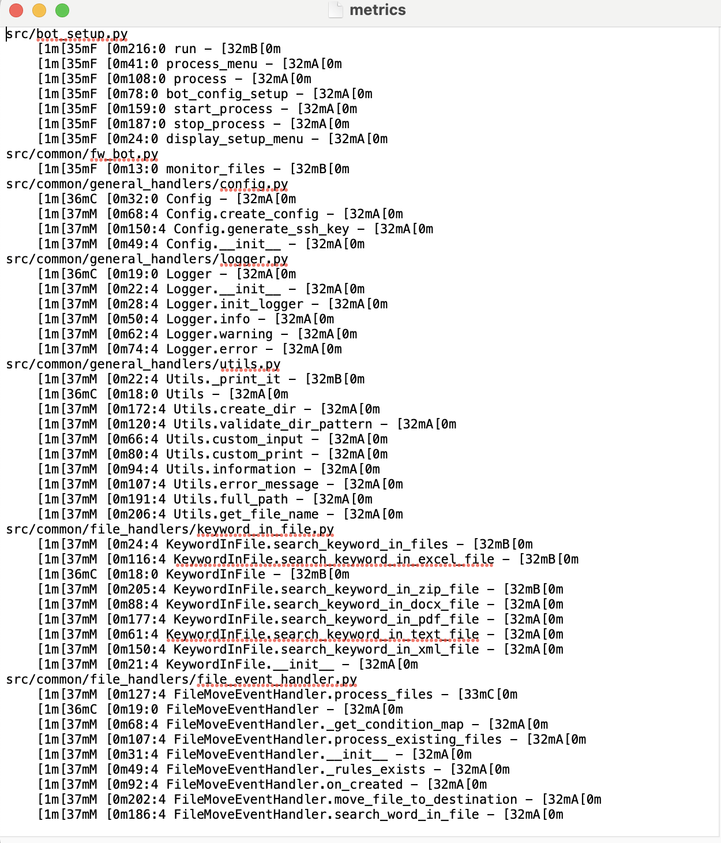

Code Quality (metrics and code repository)
Github: https://github.com/biswassandip/IA_Team_Project/blob/main/msc_ia_bot/metrics
Repository:
https://github.com/biswassandip/IA_Team_Project
Metrics
(Cyclomatic Complexity)
radon

Slide 9
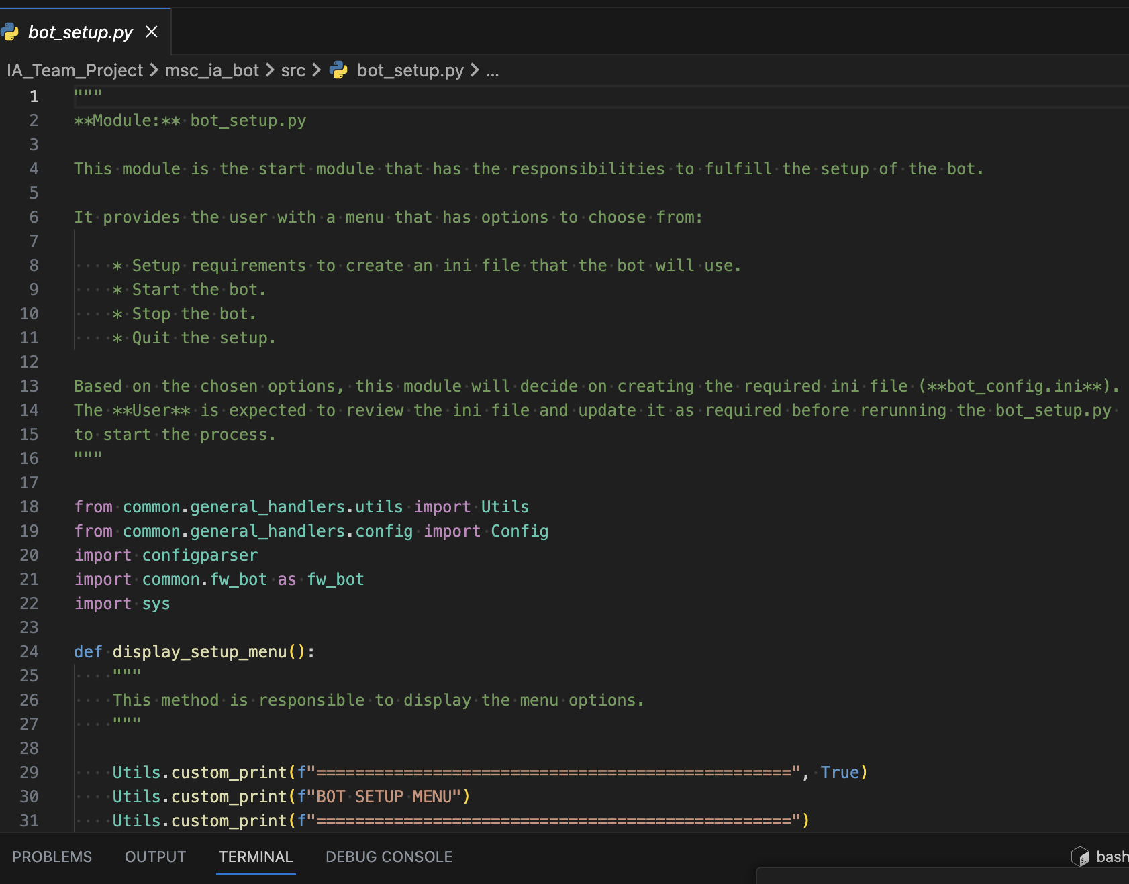
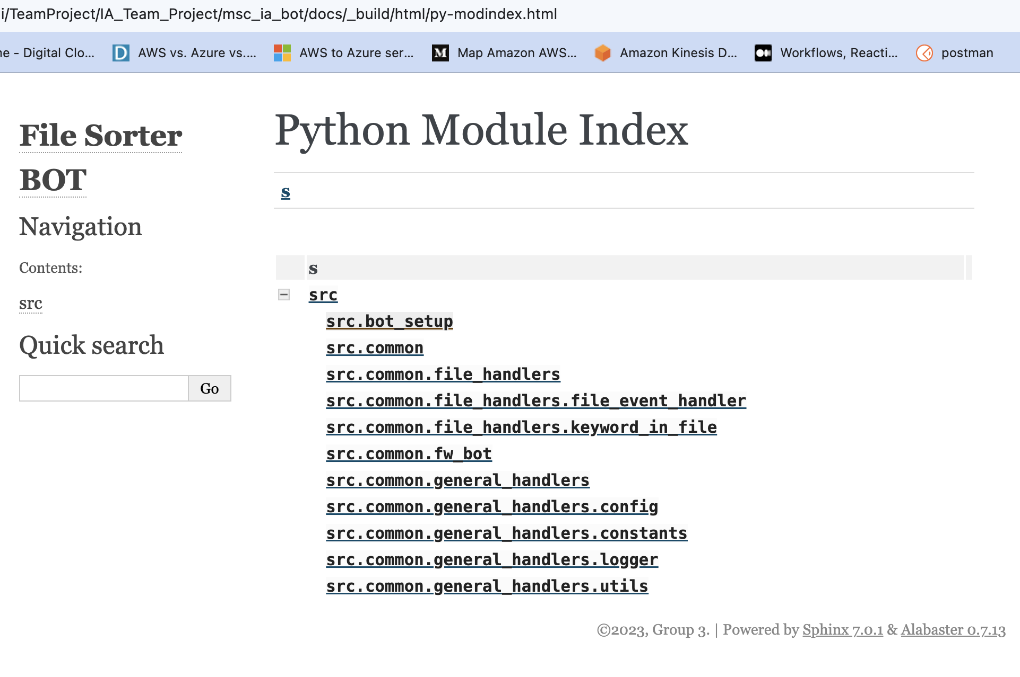
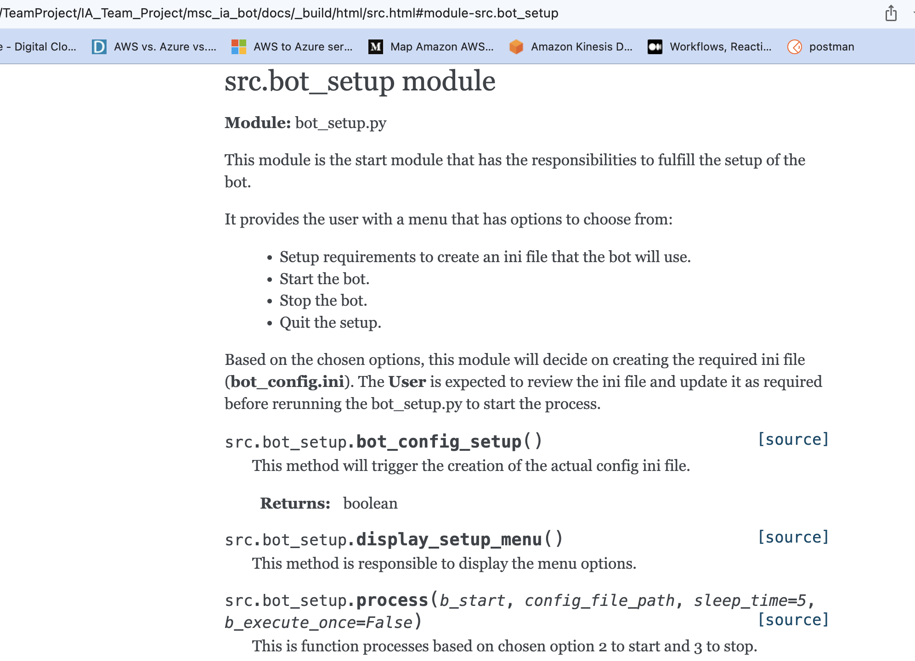
Code Quality (code comments and documenting)
sphinx
Github download - https://github.com/biswassandip/IA_Team_Project/tree/main/msc_ia_bot/docs/_build/html
folder

Slide 10
Codebase references
Codebase – The entire code has been checked into Github. Click here
Test Cases – The test cases from this project. Click here
Test Run Report – This provides the execution report and results. Click here
Test Coverage Report – This shows how much the code has been covered after running tests. Click here
Documentation – The entire code documentation and structure can be found here. Download the html folder. Click here

Slide 11
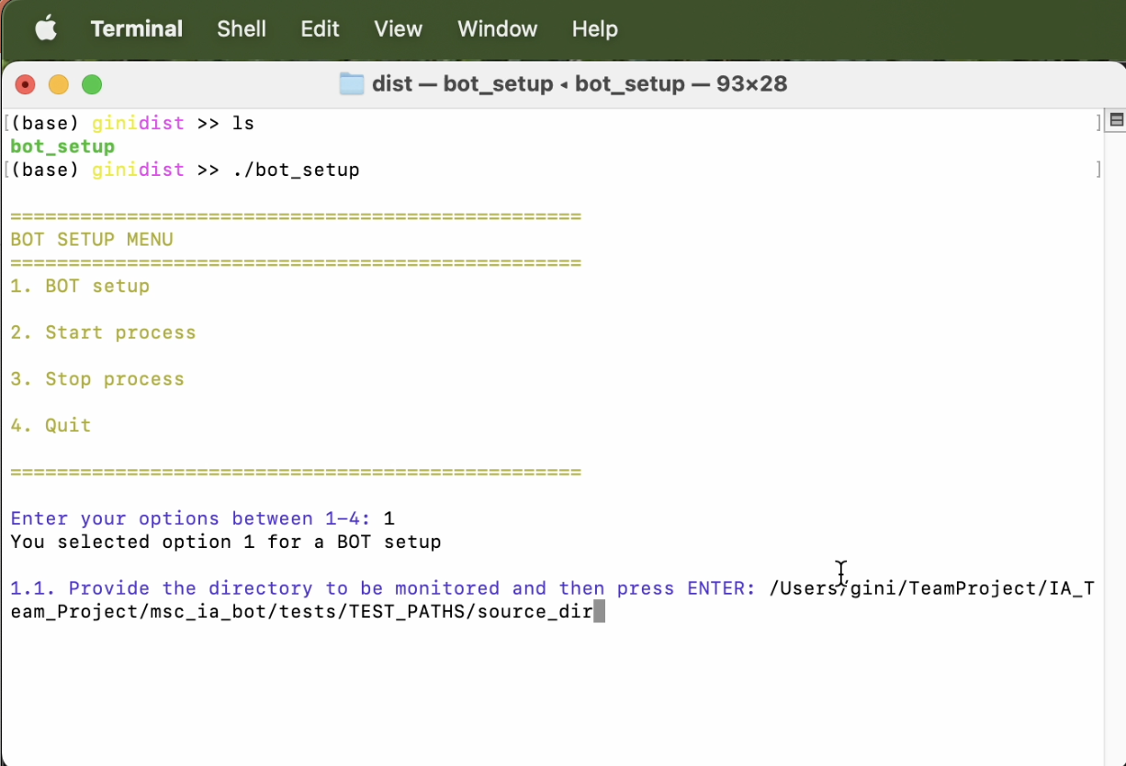
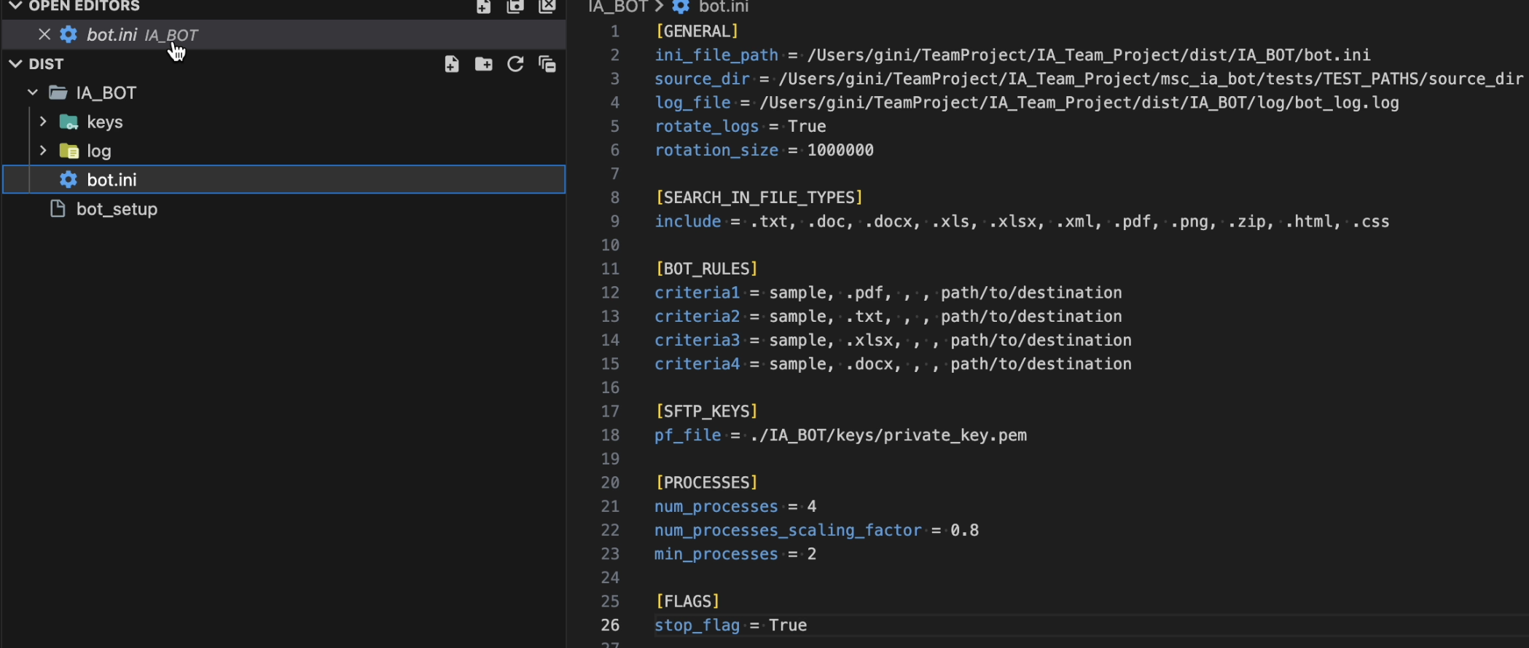
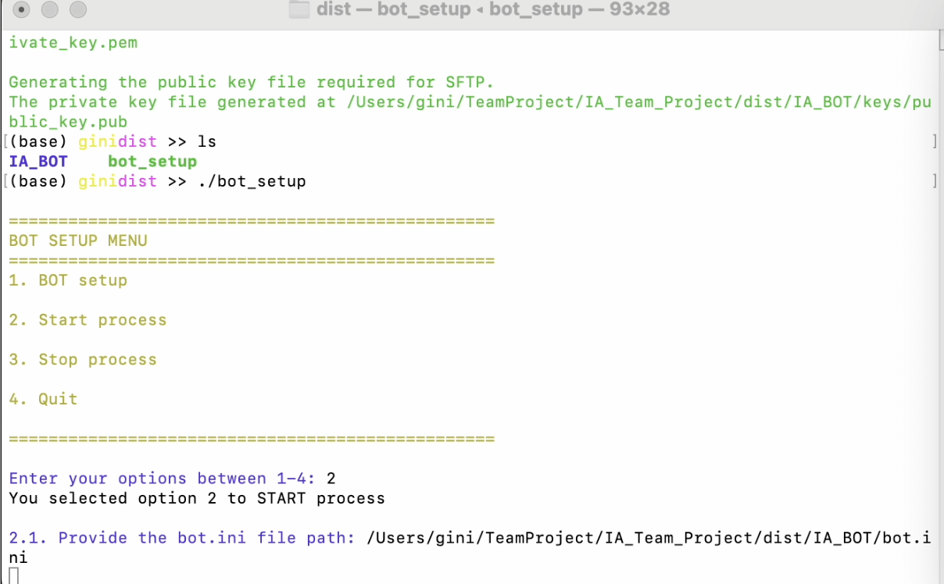
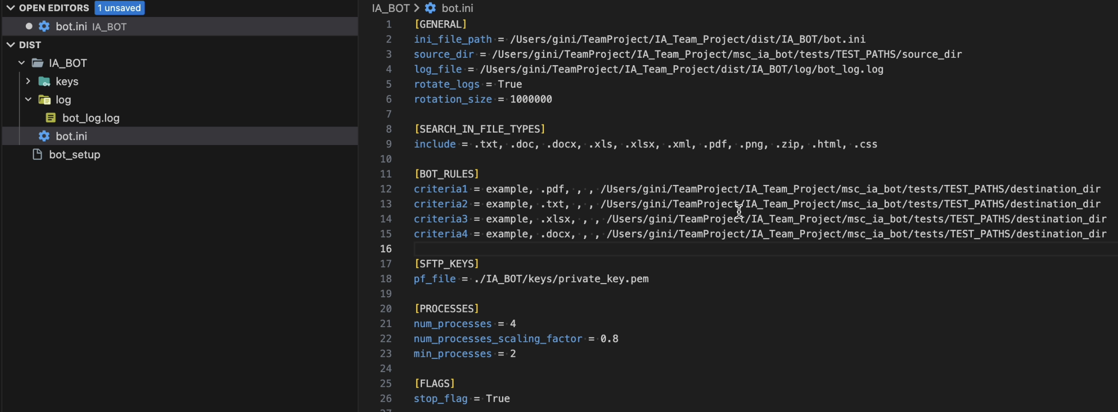
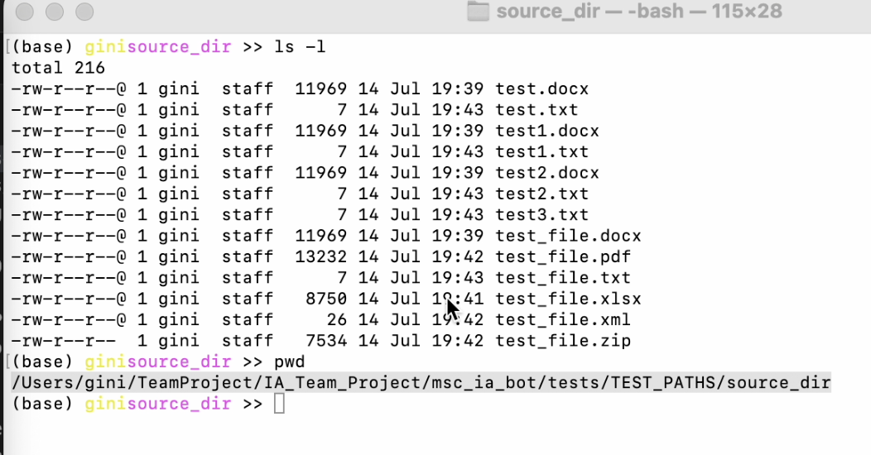
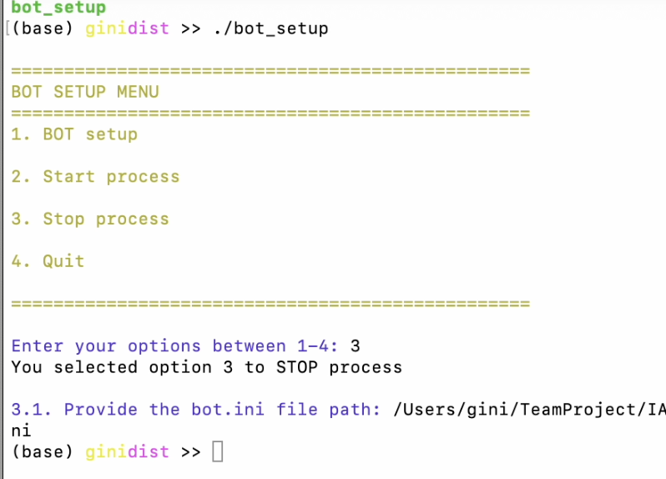
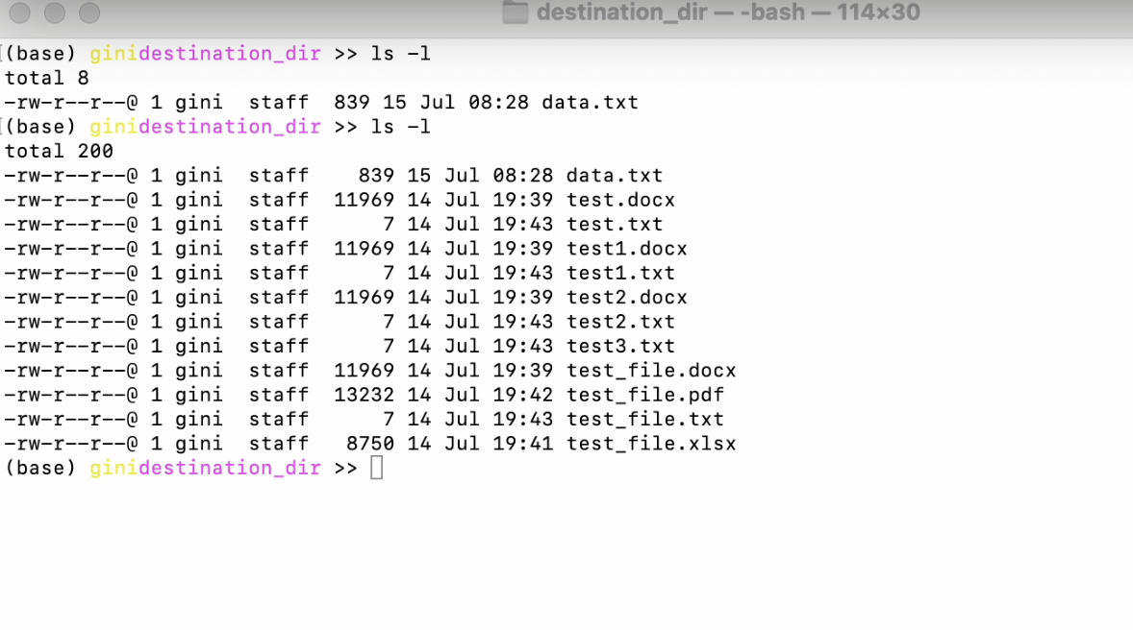
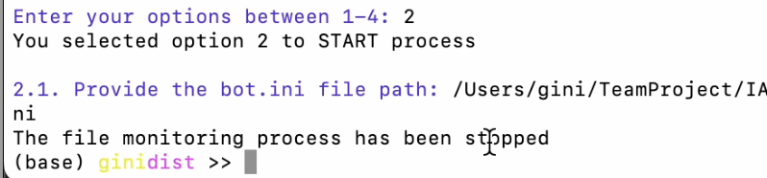
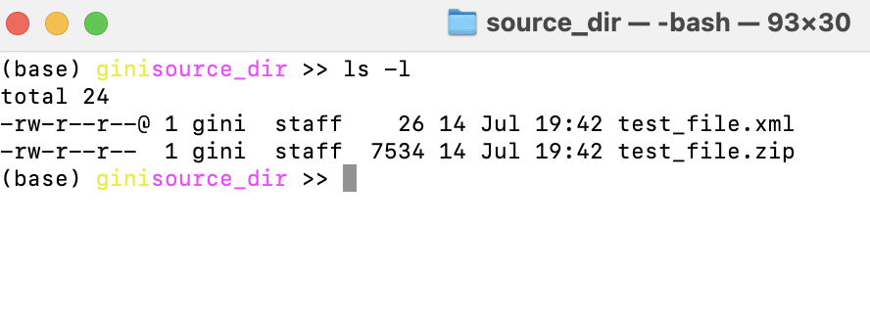
BOT Running
Config
Ini file
1. BOT SETUP
Source (before)
2. START PROCESS
3. STOP PROCESS
Process Stopped
Destn. (after)
Source (after)

Slide 12
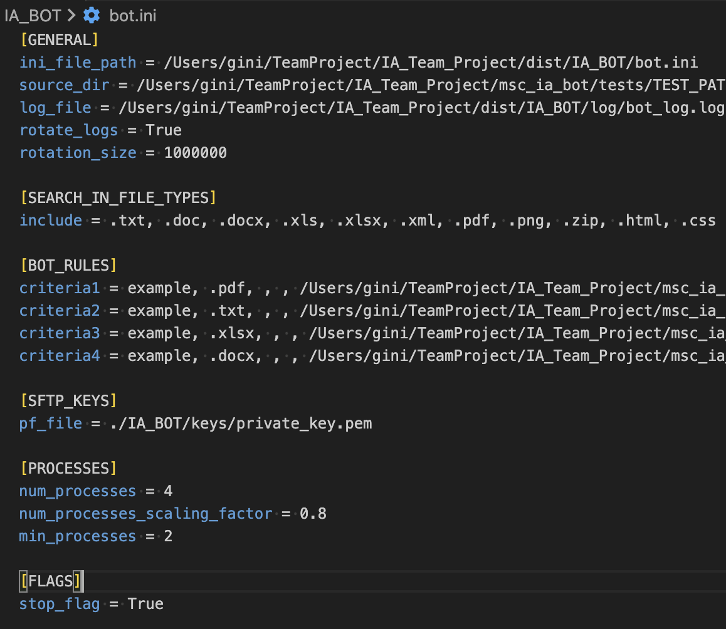
Explaining the ini configuration file
GENERAL:
Can be updated with the directory to be monitored (source_dir) and where the logs to be created
SEARCH_IN_FILE_TYPES:
List of comma separated file types that will be used to search for the keyword
BOT_RULES:
A ”criteria” or rule which is a comma separated string of the following: Keyword, file type, sftp host, sftp port, destination directory.
The SFTP Logic is an enhancement requirement to current BOT that will be implemented in next releases after reviewing the requirements more in details.
The PROCESSES are for multiprocessing enhancement for later
FLAGS -
stop_flag = True would mean that the process will be stopped

Slide 13
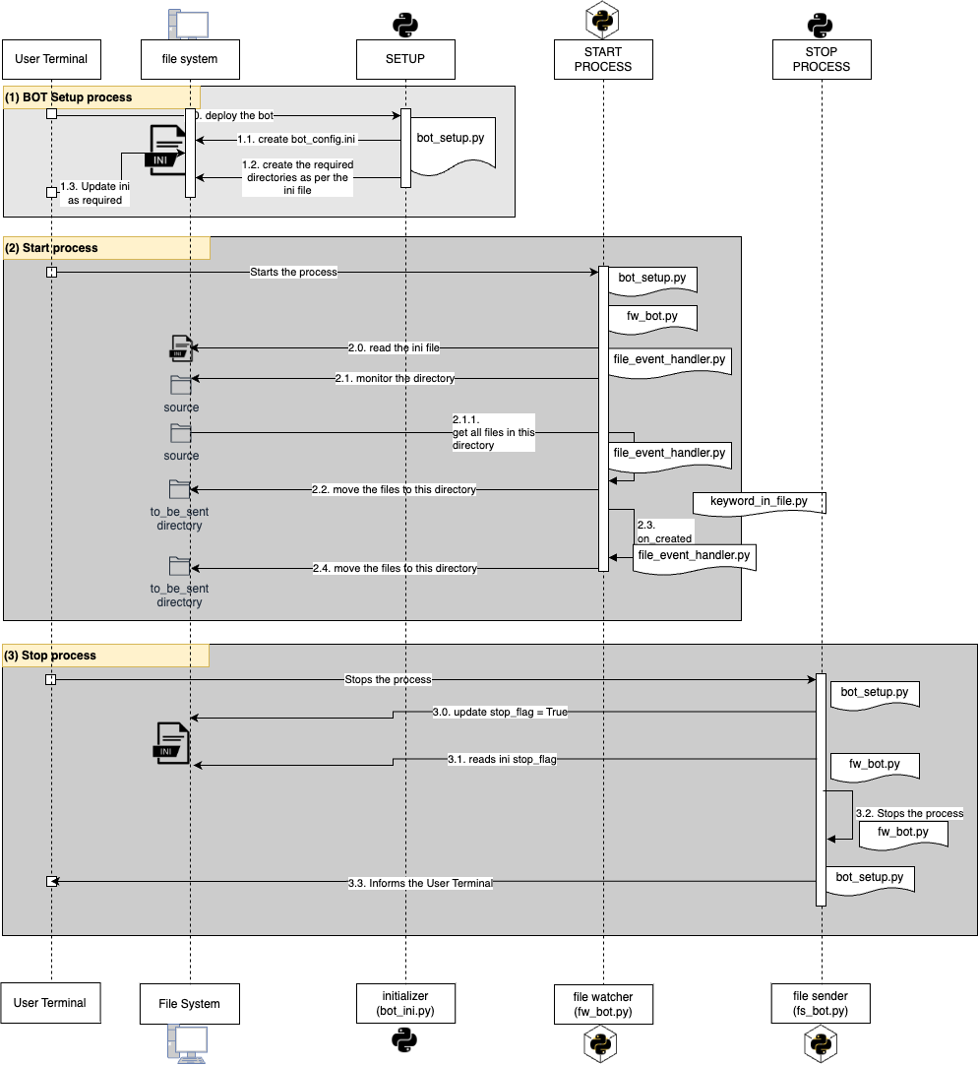
Process & Code Flow
A brief sequence is provided of when a python program is executed during a process:
SETUP Process
Responsible for creation of the configuration ini file
The User is required to review this file and update as required (refer the configuration ini slide for details)
START Process
Once the BOT has been started, it reads the ini file and performs the activities as per the BOT rules provided in the ini file
It is running until stopped
STOP Process
The running BOT can be stopped by either updating the stop_flag to True manually in the ini file or invoking the setup

Slide 14
Conclusion
The initial MVP for the Digital File Handling BOT has been built with a baseline structure and framework for future enhancements like adding SFTP and REST features for destinations. This would call for adding respective features in the configuration.
This BOT is self-sufficient and can manage based on the data inputs, thus reducing the time to manually move files based on keyword searches within the file or file types. A focused approach to refine and define the BOT rules in the configuration file would enable faster and easier management of the files.
The BOT results are supported by the coverage and test reports that can be viewed online. Moreover, the entire documentation for the packages and modules has also been built and provided through the repository.
Industry standards have been used to make sure that the initial release of the BOT codebase is maintainable and can be enhanced with better measures.

